Slide 2
Context-Free Languages

Slide 3
Context-Free Languages
Regular Languages

Slide 4
Context-Free Languages
Context-Free
Grammars
Pushdown
Automata
stack
automaton

Slide 5
Context-Free Grammars

Slide 6
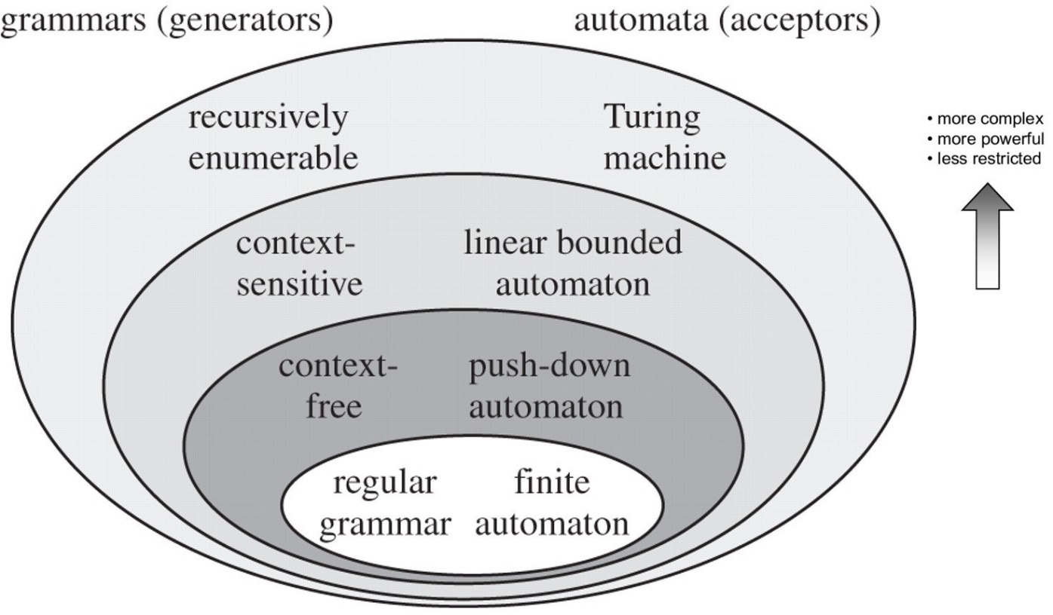

Slide 7
Example
A context-free grammar :
One non terminal → terminal/non terminal
A derivation:

Slide 8
A context-free grammar :
Another derivation:

Slide 10
Example
A context-free grammar :
A derivation:

Slide 11
A context-free grammar :
Another derivation:

Slide 14
Example
A context-free grammar :
A derivation:

Slide 15
A context-free grammar :
A derivation:

Slide 18
Definition: Context-Free Grammars
Grammar
Variables
Terminal
symbols
Start
variables
Productions of the form:
is string of variables and terminals

Slide 19
Example of Context-Free Grammar
productions
start variable
variables
terminals

Slide 20
Notation: Context-Free Grammars
Lower case letters near beginning of alphabet (e.g. a, b, c, …) are terminal symbols
Upper case letters near beginning of alphabet (e.g. A, B, C, …) are variables
Lower case letters near end of alphabet (e.g. w, x, …) are strings of terminals
Upper case letters near end of alphabet (e.g. X, Y, …) are either terminals or strings
Lower case Greek letters (e.g. α, β, γ, …) are strings of terminals and/or variables

Slide 21
Definition: Context-Free Languages
A language is context-free
if and only if
there is a grammar with

Slide 22
Recall Language of a Grammar
For a grammar
with start variable :
String of terminals

Slide 23
Example:
context-free grammar :
Since, there is derivation
for any

Slide 24
Example:
is a context-free language
since context-free grammar :
generates

